Slide 1
IBM Spectrum Protect 7.1.4
4th Quarter 2015 Technical Update
Spectrum Protect Server, Client, OC, HSM & Workstation Tricia Jiang

Slide 2
7.1.4 Spectrum Protect Overview GA 11/30/15 (Snapshot 12/11/15)
SERVER NetAPP cDOT – Support for NDMP and SnapMirror to tape
SLES12 for DB2 10.5 – xLinux & zLinux only
Performance Updates for Object Store
Platform and OS Support Matrix – Server/OC/RM
Blueprints - pLinux
OPERATIONS CENTER Customized reporting (adhoc, schedule, email)
NAS Support
Java 8
CLIENT Windows 10 Support (7.1.3.2 and 7.1.4)
Mac OS X 10.11 El Capitán (7.1.3.2 and 7.1.4)
pLinux (LE) for SLES 12 and RHEL 7
Workstations Windows 10 Support
HSM UNIX/Linux GPFS Support for zLinux
Migration of small files
HSM Windows Logging Enhancements
DP for VMware Monster VM – Phase 1
VMware virtual volume (vVol) experience – Phase 1
Snapshot - VMware Capacity reporting
Snapshot - Unix/Linux Capacity reporting
Dynamic allocation of SVC target volumes
Oracle 12c toleration
Currency: AIX 7.2, RH 7, SLES 12
Snapshot - Windows Capacity Reporting
Instant Restore for 3rd party devices

Slide 3
Server – NDMP Cluster Aware Backup for Netapp
Support for Netapp's NDMP Cluster Aware Backup (CAB) Extension
Backup of Netapp Clusters at either Cluster Wide or Storage Virtual Machine (SVM)
Data Movement within cluster is transparent to backup and restore operations
NDMP Full or Differential backups supported
NDMP SnapMirror-to-tape (“SMTape”) fully supported for Netapp clustered filers
  Snapdiff added cluster support in 7.1.2
Notes:
Node-scoped NDMP still supported

Slide 4
Server – NDMP CAB Requirements
OnTap 8.2 or later required
Netapp filers only
  N Series does not support clusters
  Other filers’ clusters currently not supported
A new node/datamover combination must be created, followed by a full backup
For local tape backup
  At least one drive must be attached to every node within the cluster to ensure all volumes backed up
  Shared drives are supported
  The filesystem and drive must be collocated on same node of cluster
    NDMP 3 way not supported
“SVMs” may only be backed up by filer-to-server over the LAN

Slide 5
Server - NetAPP cDOT – Tape Drive Configuration
Drives are connected to nodes
Drives may be shared between nodes and Spectrum Protect server
Cluster “Affinity” identifies the physical node on which a filesystem or tape drive exists
Volumes & tape drives must be collocated on same node for an NDMP backup or restore
  NDMP 3 way not supported
Spectrum Protect auto-defines data movers for each node in a cluster to be used for path definitions
  For cluster at right, two datamovers are auto-defined:
  nascluster-01
  nascluster-02
  User defines paths from auto-defined data movers to each device:
Source | Destination | Device Name
nascluster-01 | drive1 | /nascluster-01/rst2l
nascluster-01 | drive2 | /nascluster-01/rst1l
nascluster-02 | drive1 | /nascluster-02/rst1l
nascluster-02 | drive2 | /nascluster-02/rst2l
Notes:
The Netapp cluster “nascluster” is a two-node cluster. Nodes are named “nascluster-01” and “nascluster-02”
Two tape drives are attached to both nodes within the cluster
NDMP drive names indicate the node to which a drive is attached eg: /nascluster-01/rst2l
SHOW NASDEV <datamovername>
Source
Destination
Device Name
nascluster-01
drive1
/nascluster-01/rst2l
nascluster-01
drive2
/nascluster-01/rst1l
nascluster-02
drive1
/nascluster-02/rst1l
nascluster-02
drive2
/nascluster-02/rst2l

Slide 6
Server - NetAPP cDOT – Cluster wide Backup to Local Tape Procedure
All data for cluster may be stored in a single node
Setup Process:
  Configure the cluster for SVM scoped NDMP backup
  Configure user id on the cluster for NDMP backup
  Configure the network interfaces on the cluster
  Configure Spectrum Protect server
    REGISTER NODE … TYPE=NAS
    DEFINE DATAMOVER TYPE=NASCLUSTER HLA=… User=… PASSW=…
    Select and Setup paths to tape devices
TSM Node
TSM Data Movers
nascluster
nascluster
TSM Filespaces
nascluster-01
/svm1/vol1
/svm1/vol2
nascluster-02
/svm2/vol1
Defined Automatically
/svm2/vol2
IC – Intercluster Network Interface
Notes:
Setup Process - Configure the Cluster :
Refer to the following Netapp publications for collecting necessary information on cluster:
Clustered Data OnTap 8.3: NDMP Configuration Express Guide
Clustered Data OnTap 8.3: Data Protection and Tape Backup and Recovery Guide
Clustered Data OnTap 8.3 Commands: Manual Page Reference
Log in to the command line console of the cluster using the cluster-management interface
Enable SVM-scoped NDMP on the cluster
system services ndmp node-scoped off
Setup Process - Configure the Cluster :
Configure the NDMP user id and password for cluster-wide access
Identify the special “admin” SVM on the cluster:
vserver show -type admin
Enable NDMP on the admin SVM
vserver services ndmp on -vserver adminSVM
Create user for NDMP operations
security login create -user-or-group-name backup_admin1 -application ssh
-authmethod password -role backup
Generate a new password for this user
vserver services ndmp generate-password -vserver adminSVM -user backup_admin1
Setup Process - Configure the Cluster :
Configure an Intercluster network Interface on cluster for NDMP operations
Ensure all nodes in cluster have an intercluster logical interface (LIF)
network interface show -role intercluster
Allow NDMP through the firewall of the intercluster interfaces
system services firewall policy modify -vserver adminSVM -policy intercluster -service ndmp 0.0.0.0/0
Modify “failover” policy for intercluster interfaces to “local-only”
network interface modify -vserver adminSVM -lif IC1 -failover-policy local-only
Specify the interface types needed for NDMP data connections with the “preferred-interface-role”
vserver services ndmp modify -vserver adminSVM -preferred-interface-role intercluster,cluster-mgmt,node-mgmt
Setup Process - Configure a Node and Data mover on TSM:
Get the IP address, userid and password on cluster for NDMP operations
Find an intercluster network interface
network interface show -role intercluster
Use the backup user created with “security-login create” command
Use the password generated by “vserver services ndmp generate-password” command
Register a NAS node and Data mover.
Example: Register a node named “NASCLUSTER” for a Netapp cluster:
REGISTER NODE NASCLUSTER *** TYPE=NAS
DEFINE DATAMOVER NASCLUSTER TYPE=NASCLUSTER HLA=... USER= PASSW=
Additional data movers are defined automatically for each physical node found in the cluster
Setup Process - Define Paths to drives
Gather the following data from the Netapp Cluster for defining drive paths:
Identify all tape devices and the nodes to which each device is attached.
node hardware tape drive show -node cluster-01
Identify device name and serial number for each device
storage tape show-tape-drive
Note that the server's “SHOW NASDEV” command may be used Ex:
Device: /tsmcluster-02/rst14l
Description: Hewlett-Packard LTO-4
Capacity: 81633 bpi 40GB cmp DLTIV
WWN: WWN[2:000:0000c9:8fbbc8]L6
Serial Number: SN[6283198003]L6
Select a path for the library device – either from TSM server or one of the node specific data movers
Define paths to each drive from each node specific data mover

Slide 7
Server - NetAPP cDOT – SVM level Backup Procedure
Storage Virtual Machine (SVM) level backup must be filer-to-server
Setup Process :
  Configure the cluster for SVM scoped NDMP backup
  Configure user id for each SVM on the cluster for NDMP backup
  Configure the network interfaces for the SVMs
  Configure Spectrum Protect server
    REGISTER NODE … TYPE=NAS
    DEFINE DATAMOVER …. TYPE=NASVSERVER HLA=… User=… PASSW=…
    Select storage pools local to SP server for backup and TOC data
    Set policy appropriately
Notes:
Setup Process - Configure the Cluster :
Refer to the following Netapp publications for collecting necessary information on cluster:
Clustered Data OnTap 8.3: NDMP Configuration Express Guide
Clustered Data OnTap 8.3: Data Protection and Tape Backup and Recovery Guide
Log in to the command line console of the cluster using the cluster-management interface
Enable SVM-scoped NDMP on the cluster
system services ndmp node-scoped off
Setup Process - Configure the Cluster :
Configure the NDMP user id and password for the SVM
Identify the SVM on the cluster:
vserver show -type data
Enable NDMP on the SVM
vserver services ndmp on -vserver svm1
Create user for NDMP operations
security login create -vserver svm1 -user-or-group-name vsndmp -application ssh -authmethod password -role vsadmin-backup
Generate a new NDMP password for this user
vserver services ndmp generate-password -vserver svm1 -user vsndmp
Setup Process - Configure the Cluster :
Configure a data network Interfaces on cluster for NDMP operations
Ensure all nodes in cluster have an intercluster LIF
Find a data network interface assigned to the SVM
network interface show -vserver vs1 -role data
Ensure assigned firewall policy allows NDMP through the data interface
network interface show -vserver vs1 -lif IC1
system services firewall policy show -policy <policy shown above>
Specify the interface types needed for NDMP data connections with the “preferred-interface-role”
vserver services ndmp modify -vserver adminSVM -preferred-interface-role intercluster,data
Configure the server
Example: To register a node named “svm1” to hold backup data for an SVM in a cluster:
REGISTER NODE SVM1 *** TYPE=NAS
DEFINE DATAMOVER SVM1 TYPE=NASVSERVER HLA= USER= PASSW=
Use IP address for data interface on SVM, user Id and password identified previously
Select storage pools local to the TSM server for backup data and TOC data and set policy appropriately.

Slide 8
Server – 256K tape Blocks for Netapp File Servers
Support NDMP backups with 256K tape blocks on Netapp file servers
Improves performance
OnTap 8.3 or later required
Netapp only support
Restore of images created with either 64K and 256K supported
  Block size is stored in metadata of backup object
NDMP Plugin
  For Netapp filers running OnTap 8.3 and newer set block size to 256K during backup
  During restore
    Read DATA_BLOCK_SIZE NDMP environment variable from metadata
    Set block size using this value
SS (remote path)
  Storage Services manages allocation of space on tape or file volumes
  Save blocksize used in “storage format” field

Slide 9
Server - Performance Updates for Object Store
Under the cover performance update to Object Store
7.1.4 vs. 7.1.3 cloud performance
On-premise:
  Larger object workloads (10+ MB): Approximately 30% increase in direct backup throughput
  Smaller object workloads (<10 MB): Unchanged
Off-premise:
  Larger object workloads (10+ MB): Approximately 30% increase in direct backup throughput
  Smaller object workloads (<10 MB): Unchanged
FAQ information
  https://www.ibm.com/developerworks/community/wikis/home?lang=en#!/wiki/Tivoli%20Storage%20Manager/page/Cloud-container%20storage%20pools%20FAQs

Slide 10
Server - Blueprints – pLinux
New blueprint for Linux on Power (big endian) including:
  New .pdf reference
  Automated scripting support
Hardware similar to AIX blueprint
  Using Power 8 S822-L model
Configuration steps similar to Linux x86
http://ibm.biz/IBMSpectrumProtectBlueprints

Slide 11
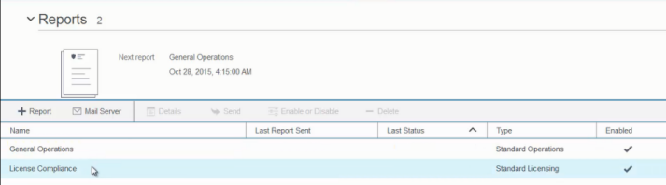
OC - Customized reporting (adhoc, schedule, email)
New Tab for Reports on main banner
  Out of the Box General Operations & License Compliance report also here
User must initially configure the mail server on install
  Required info: Admin ID, Mail Server Address, Port Number
New Features: Send, Enable / Disable, Details
Demo: https://youtu.be/nJl8i6m08vw

Slide 12
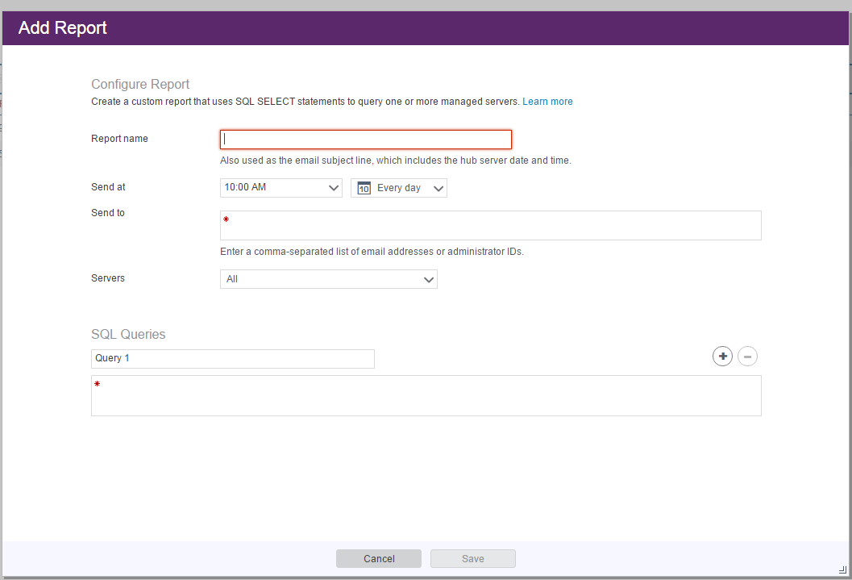
OC - Customized reporting (adhoc, schedule, email)
Adhoc reporting reminiscent of version 5 Operational Reporting
Can schedule to run at a sepecific time every day or on specific days of the week
Send to field must contain valid email or Spectrum Protect admin ID
Can send SQL to single server or all servers monitored by OC
  Downlevel servers supported
  Must be System admin on that server
Only Select commands allowed
  SQL max size = 1450 characters
  5000 rows per query
  Checks SQL command for validity

Slide 13
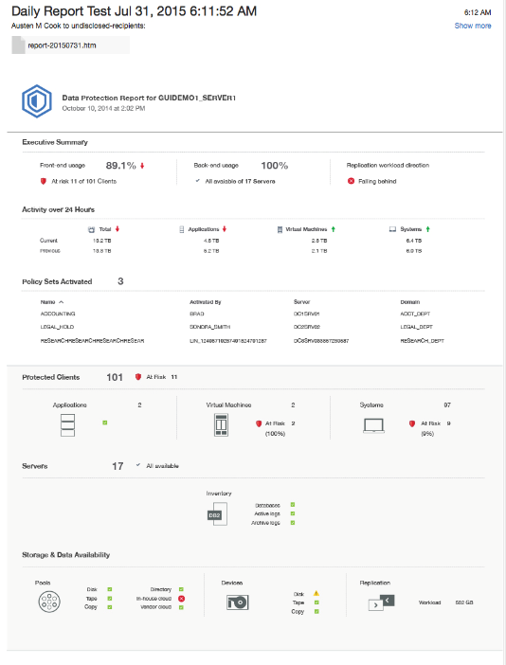
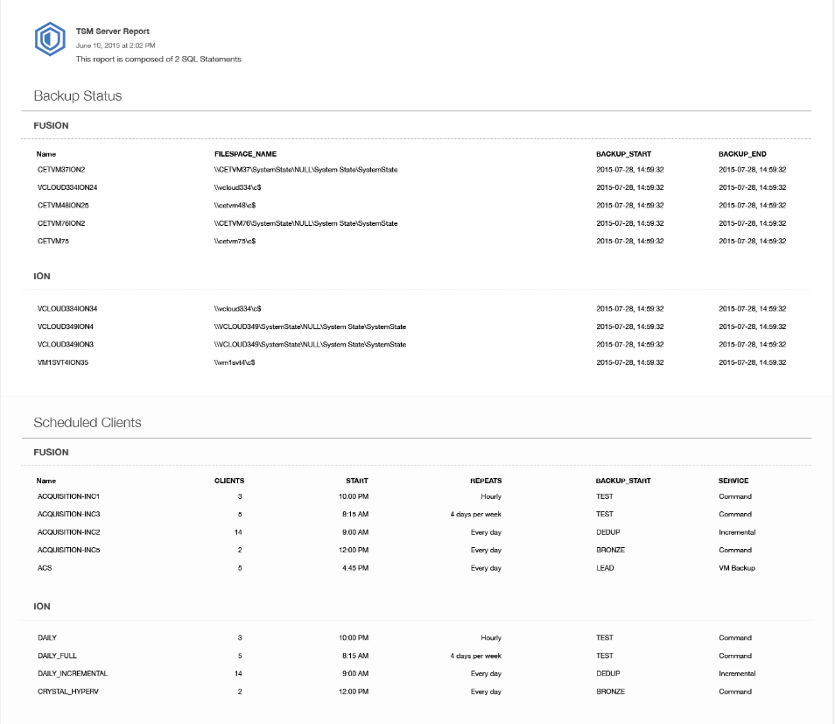
OC – Report Examples
General Operations Report
Customized Report

Slide 14

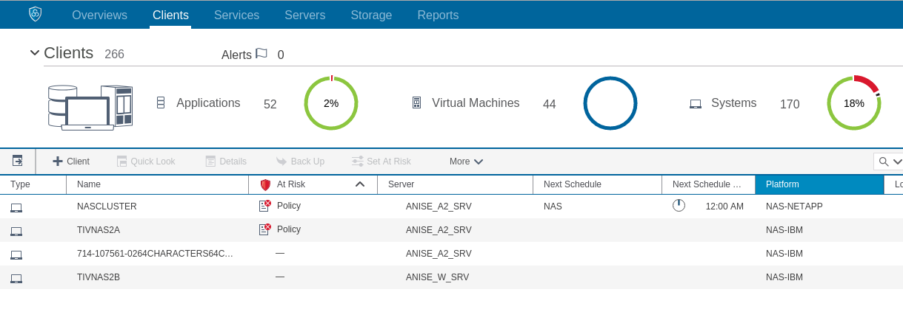
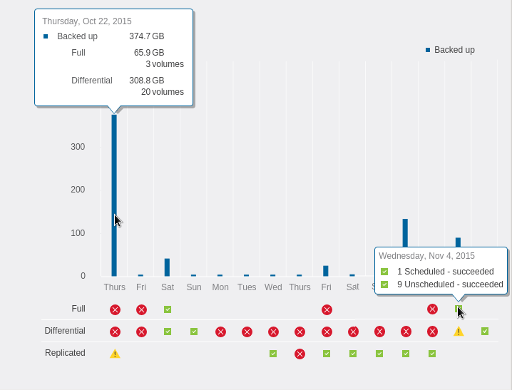
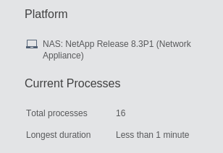
OC – NAS
NAS “visibility” to NDMP and SnapMirror to tape provided in 7.1.4
Client nodes defined with type=NAS
  q node * type=nas
Spoke and Hub server must be at 7.1.4
Clients Table:
    Next Schedule
    Platform
    At Risk status
Clients Details:
  Overview with 2-week history
    Platform and Current Process running
    Hover over amount of data backed shows fulls & differentials
    Hover over status shows:
      Number of tasks run that day
      scheduled -vs unscheduled,
      Succeeded or failed

Slide 15
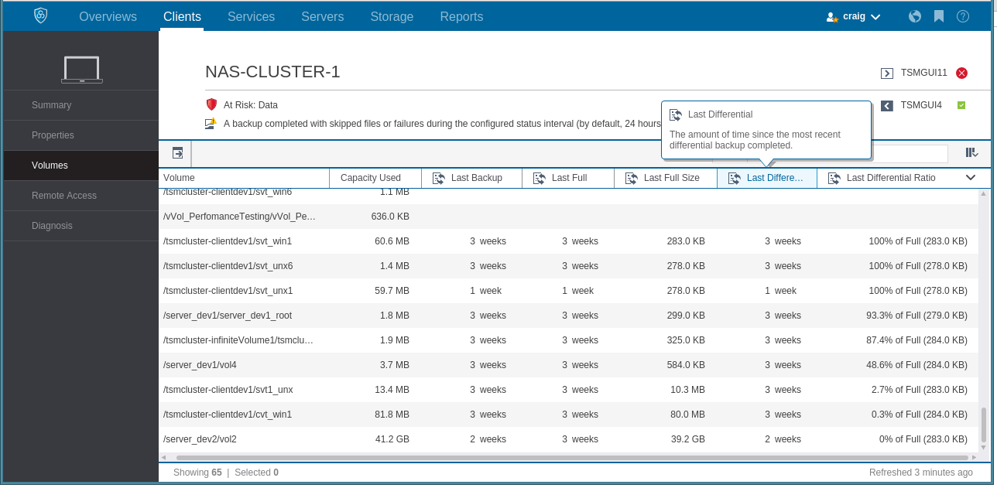
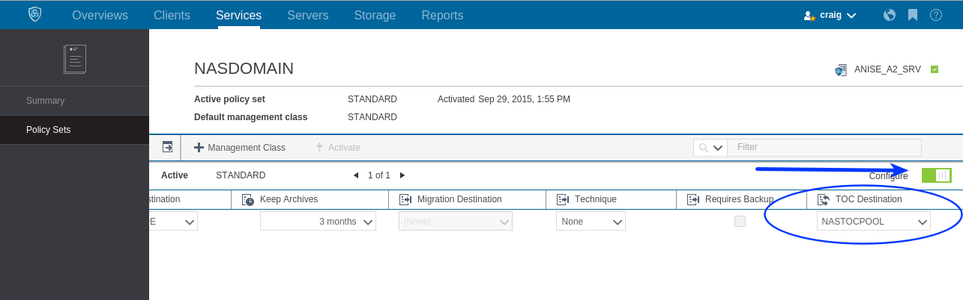
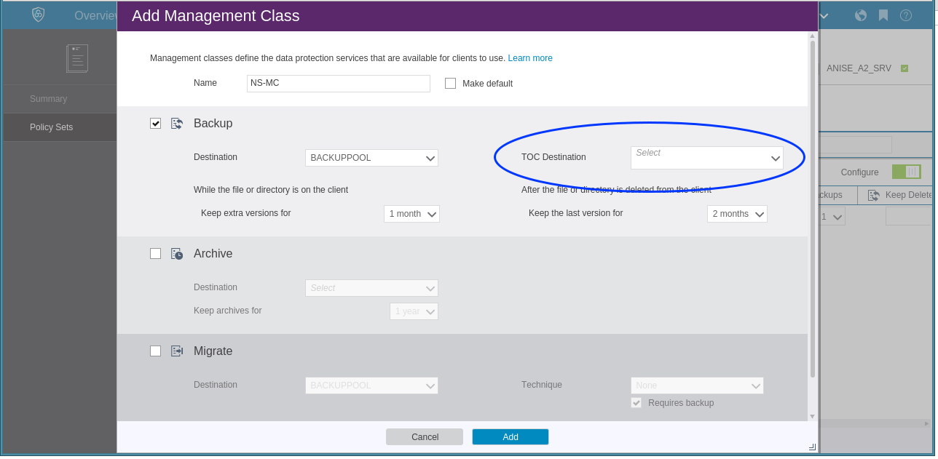
OC – NAS
Clients Details (cont):
  Volumes table: last backup dates & sizes
    Last backup of each volume
    The Ratio of differential to full backups
    Volumes never backed up shown too
Services Update management class
  Table of Contents destination added to Management Class configuration
Services Create management Class:
  Table of Content Destination Stgpool
  DEMO: https://youtu.be/kadWBzLbiXU

Slide 16
Server, OC, Client, Workstation – Platform Updates
Server
  SLES12 for DB2 10.5 – xLinux & zLinux only
OC
  Java 8.0.2
  Liberty 8.5.5.7
Client
  Windows 10 support
    Spectrum Protect Client version 7.1.3.2 and 7.1.4
    No support for Edge browser
  Mac OS X 10.11 El Capitán
    Spectrum Protect Client version 7.1.3.2 and 7.1.4
    Symbolic link locations changed from /usr/bin and /usr/lib to /usr/local/bin & /usr/local/lib
  pLinux LE (see next slide)
IBM Spectrum Protect for Space Management
  Linux on z System (see slide)
    For IBM Spectrum Scale
Spectrum Protect for Workstation
  Windows 10 support for client

Slide 17
Client - pLinux (LE) for SLES 12 and RHEL 7
IBM Spectrum Protect backup archive client supported on Linux on Power Systems™
  Little Endian
  a.k.a. pLE
Operating systems supported
  RedHat Enterprise Linux 7.1 (RHEL 7.1)
  Suse Linux Enterprise Server 12 (SLES 12)
File system types supported
  All Linux file system types
  IBM Spectrum Scale 4.1.1.3 (a.k.a. GPFS 4.1.1.3) or higher 4.1.1.x release level
Backup functions supported
  File system backup using Spectrum Protect stand alone
  For Spectrum Scale file system type:
    File system backup using mmbackup
    Including AFM environments
  Journal based backup (not Spectrum Scale)
Enhanced Spectrum Protect functions supported
  Client push - push out PTF updates to already defined Spectrum Protect clients
Notes:
Power8 introduced Little Endian

Slide 18
HSM UNIX/Linux – zLinux Support
IBM Spectrum Protect for Space Management for IBM Spectrum Scale for Linux on z System
Operating systems supported
  RedHat Enterprise Linux 7.1 (RHEL 7.1)
  Suse Linux Enterprise Server 12 (SLES 12)
File system types and versions supported
  IBM Spectrum Scale 4.2 (a.k.a. GPFS 4.2) GA 4Q15
Space Management support fo Linux on z Systems equal to functions for Linux on x Systems
Spectrum Scale policy engine driven threshold migration is supported
  Backup Function supported:
    File system backup using SP stand alone
    File system backp using mmbackup (including AFM environments)
SoBAR is supported
Mixed Spectrum Scale clusters are supported
  All SP for Space Management nodes in a mixed cluster must have the same operating system type
Notes:
mmbackup is for backup
SoBAR is disaster recovery solution requires HSM and BA client

Slide 19
HSM UNIX/Linux – Small File Support
History of Spectrum Scale Small Files:
Spectrum Scale 4.1 and newer, stores data of small files in the metadata area (inode table)
  Not stored in the data area of the file system
The size allocated for these files is zero bytes
Prior to 7.1.4, migration with Spectrum Protect for Space Management was not allowed
  Migration of these files doesn't free any space in the file system
Spectrum Protect for Space Management 7.1.4 support:
Beginning with 7.1.4 the migration of zero bytes files is possible
Enables:
  Pre/migration of all files with Spectrum Protect for Space Management, so a valid copy of all the files exist in the Spectrum Protect server
  SOBAR (scale out disaster recovery) to have a Spectrum Protect for Space Management copy of all files in the Spectrum Protect server
  Spectrum Archive integration with Spectrum Protect for Space Management to have the ability to migrate all files to LTFS tape

Slide 20
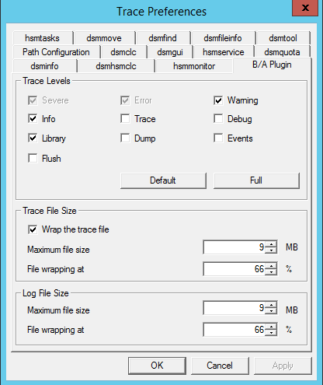
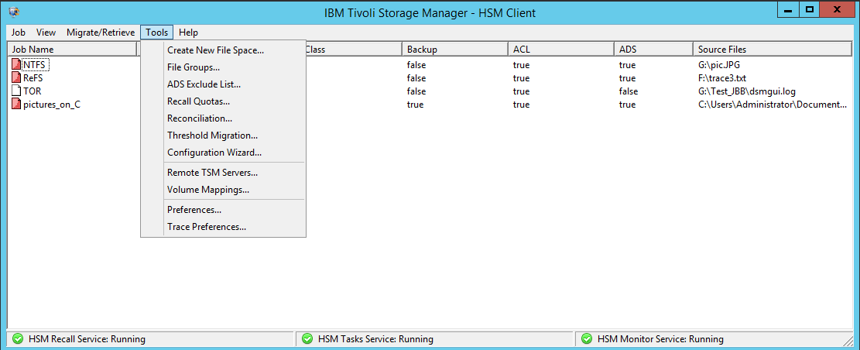
HSM Windows – Logging Enhancements
Problem analyses can require collection of a very large number of trace entries
Previously, trace files wrapped when they were full, overwriting earlier traces
New “Wrap the trace file” preference check box
ON is default
  “File wrapping at” defines % of the log file that is kept when “Maximum file size” is reached
OFF allows trace files to grow to “Maximum file size”
  Trace file’s name extended with a date and time stamp
  When max size reached, the file is closed and a new trace file is opened
Check box doesn’t apply to admin-log files containing only error & warning messages

