Slide 1
Spectrum Protect for Virtual Environments 7.1.4
Spectrum Protect Snapshot 4.1.4
4th Quarter 2015 Technical Update
Sean Sperry

Slide 2
Quarterly Release Highlights – 4Q – December 11, 2015
Spectrum Protect Server, Client, and Operations Center
NetAPP cDOT – Support for NDMP and SnapMirror to tape
Performance updates for object storage
Component platform updates – Windows 10, SLES 12, OS X and others
Operations Center reporting and NDMP enhancements
HSM Unix Spectrum Scale support on zLinux
Spectrum Protect Snapshot, Databases, and Virtual Environments
VE VMware support for VMs up to 8TB
VE VMware VVol support
Snapshot Windows Instant Restore for Non-IBM devices

Slide 3
Spectrum Protect for Virtual Environments 7.1.4 – Large VM Support
Added VM backup / restore support of VMs containing virtual disks up 8 TB in size
  VMware only
Added new option VMMAXVIRTUALDISKS
  Default maximum still set at 2TB
  VMMAXVIRTUALDISKS <max size in TB>
Performance Overview
    Spectrum Protect for Virtual Environments: Data Protection for VMware V7.1.4 backs up and restores virtual machines that have virtual disks (vmdk) larger than 2 TB.
    As the size of vmdks increase, the processing time of an initial full backup and full restore increases proportionally. The processing time to back up an 8 TB vmdk for the first time takes approximately 4x longer than an initial backup of a 2 TB vmdk, depending on the speed of the environment. After the first full backup, subsequent incremental backups require considerably less time, depending on the amount of changed data.
    The processing time to complete a full restore of an 8 TB vmdk takes approximately 4x longer than a restore of a 2 TB vmdk, depending on the speed of the environment. If only a few files must be restored, use the Tivoli Storage Manager file restore interface to restore the files. You can search and restore individual files without the processing time that is required to restore a full VM.

Slide 4
Spectrum Protect for Virtual Environments 7.1.4 – Large VM Function Support
The following table shows, for each function, what is supported at this level with > 2 TB:
Function | Supported w/ > 2 TB | Blocked (if not supported)
Incremental Forever (IFFull / IFIncr) Backup/Restore | Yes | N/A
Periodic Full (FULL / INCR) - old style | No | Yes
File Restore using Recovery Agent | Yes | N/A
Self Service Restore GUI | Yes | N/A
Instant Access / Instant Restore | Yes | N/A
Cooperative Application Protection (SQL Server and Exchange) | No | Yes
Snapshot Offload | No | No

Slide 5
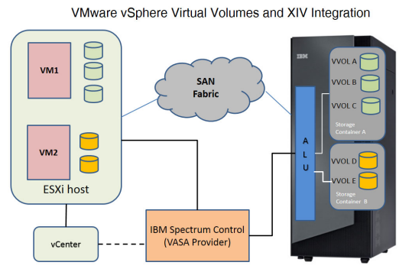
VMware Virtual Volumes in vSphere 6.0
vSphere 6.0 Virtual Volumes provide a layer of abstraction between vSphere and connected SAN and NAS storage device
The API used for VVols is called the VMware Storage Awareness (VASA 2) API
  VASA 2 Provider
It is up to each storage subsystem vendor to create their own VASA 2 Provider if they want to support VVols
  XIV Gen 3 and SVC both have this component and therefore support VVols
For XIV and SVC, Spectrum Control Base acts as the VASA 2 Provider

Slide 6
Spectrum Protect for Virtual Environments 7.1.4 – VMware VVol Support
The following features are supported in Spectrum Protect 7.1.4 for VMs that reside on VVol datastores:
  Backing up and restoring VMs that are on VVol datastores regardless of which vendor’s implementation is used
  Physical and Virtual datamovers are both supported as permitted by the transport type
  Mixed environments with some VMs on traditional datastores and others on VVols is supported.
The following features are not supported in Spectrum Protect 7.1.4 for VMs that reside on VVol datastores:
  Instant Restore
  Instant Access
  Cooperative Application Support (SQL Server and Exchange – include.vmtsmvss)
  Lan-Free Data Transfer (Not supported by VMware)
  Backup and Restore of VMWare Storage Policy associated with a VM

Slide 7
Spectrum Protect Snapshot on Windows – Types of Snapshot Restore
VSS Fast Restore
VSS Instant Restore
Restore from Spectrum Protect Server storage
Restore by using file-level copy from mounted snapshot
Restore by using volume-level copy from snapshot (hardware-assisted)
Hardware-assisted restore
Only available on XIV, SVC based storage devices, DS8000, and Storwize V7000 at version 4.1.3 and earlier
VSS Restore

Slide 8
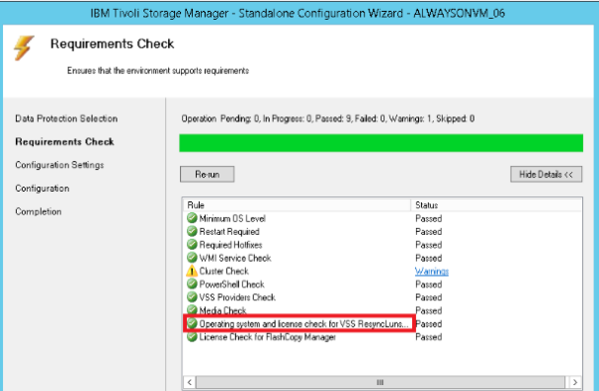
Spectrum Protect Snapshot 4.1.4 on Windows – Instant Restore on 3rd Party Devices
Beginning at version 4.1.4, Spectrum Protect Snapshot uses the VSS ResyncLuns API to perform instant restore
  For 3rd party storage devices that support VSS ResyncLuns API, Instant Restore is supported
  Exchange, SQL Server, Filesystem and custom applications are supported
Backup must be created as transportable snapshot to use VSS ResyncLuns API
  Enable option IMPORTVSSSNAPSHOTSONLYWhenneeded
  Verify with API support with 3rd party storage vendor
    Windows VSS framework does not provide a reliable programmable way to detect if the VSS hardware provider supports ResyncLuns API

Slide 9
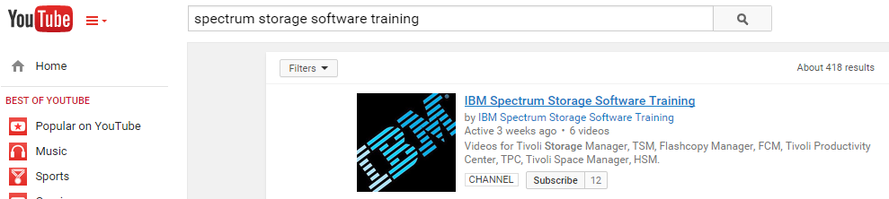
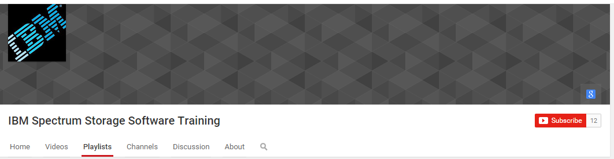

IBM Spectrum Protect 7.1.4 new features recordings on YouTube
On YouTube, search for Spectrum Storage Software Training
Open the Playlists tab and select New Features for Spectrum Protect 7.1.3 (TSM 7.1.3).
Open Channels to connect to Tricia Jiang’s and Sean Sperry’s channels.

Slide 10
References
  Subscribe to Our YouTube Channels
    Spectrum Storage Software Training
      https://www.youtube.com/channel/UCGkjRNkO0AQNyQbWhS1tTzw
    Tricia Jiang
      https://www.youtube.com/user/TSMevangelist
    Sean Sperry
      https://www.youtube.com/user/seansperry
  Tricia Jiang and Sean Sperry Video Blog
    https://sean-sperry.squarespace.com
  Version update technical overview information and presentations
    https://sean-sperry.squarespace.com/versions/

