Slide 1
Zowe V3 LTS: Office Hours for Extenders
Zowe™, the Zowe™ logo, and the Open Mainframe Project™ are trademarks of The Linux® Foundation

Slide 2
Agenda
Zowe Releases Timeline & Conformance
New Features
Breaking Changes
V3 Conformance
Resources
Q & A

Slide 3
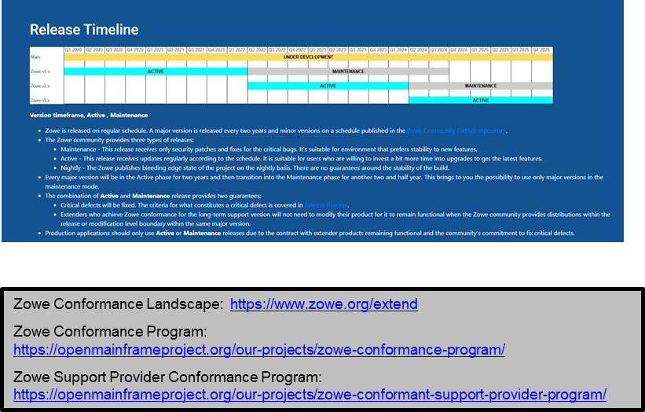
Zowe Releases Timeline & Conformance
Zowe v1 Conformance
Aligns with Zowe v1 LTS
Covers Zowe 1.9 – 1.28.x
Terminates with V1 maintenance @ Sept 2024
Zowe v2 Conformance
Aligns with Zowe v2 LTS
Covers Zowe 2.0 – Zowe 2.x (active & maintenance)
Extenders re-applied to earn v2 conformance
Support providers re-applied to earn v2 conformance
Zowe v3 Conformance
Will align with Zowe v3 LTS
Extenders must re-apply to earn v3 conformance
Support Providers must re-apply to earn v3 conformance

Slide 4
Zowe V3 New Features Improvements
Zen Installation
Continued improvements to configuration experience
More schema validation for quicker error identification
Improving `zwe` performance by shifting from pure shell to shell+config manager
Richer zowe.yaml experience - templating, system symbols, merging
`zwe diagnose` command to help troubleshooting errors

Slide 5
Zowe V3 New Features Improvements
SBOM Format Refresh (SPDX)
Delivery mechanism
Digitally signed artifacts
All artifacts produced by the Zowe community and made available on zowe.org will be digitally signed, and instructions to use those signatures will be part of the download process
Additionally: investigating sigstore integration

Slide 6
Zowe V3 Breaking Changes
No breaking changes planned
Building out stricter schema validation may (rarely) cause a previously passing command to fail.
The command was running in error before
New FMID for Zowe v3
APIML will require Java 17; Java 17 requires z/OS 2.5

Slide 7
Zowe V3 Conformance
No changes to conformance program

Slide 8
Zowe V3 Timeline
Pre-release
Zowe V3 release target is March 28, 2024
Office hours for extenders
xxxxxxx
MMM 2023
March 28, 2024
October 2023
November 2023 to
February 2024
V3 Pre-release available for testing
Zowe V3 release

Slide 9
Zowe V3 Resources
https://www.zowe.org/vnext

Slide 10
Zowe V3 Contacts
Systems Squad
Mark Ackert <mark.ackert@broadcom.com>
OJ Celis <oscarjr.celis@ibm.com>
James Struga <jstruga@rocketsoftware.com>

Slide 11
Thank you! Questions?

